Slide 1




13 Treatment Schools
5 Control Schools
ALfA Fast & Holistic FLN
Maldives
Research Findings
PILOT Phase 1

Slide 2
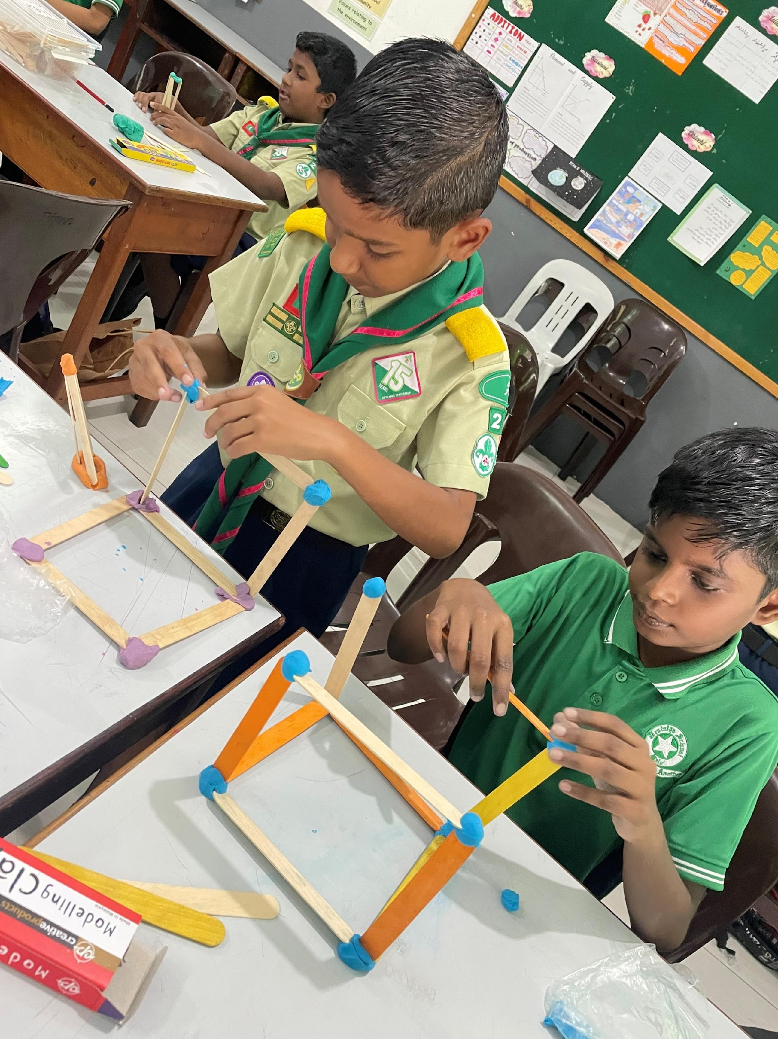
ALfA Fast & Holistic FLN
Spearheading Educational Innovation in FLN in Partnership with the Maldives Government with Support from UNICEF
Maldives Government has placed the highest priority of its education on foundational literacy and numeracy.
In this context, the National Institute of Education, Ministry of Education, engaged DEVI Sansthan to undertake pilot of its groundbreaking fast and holistic pedagogy of ALfA: Accelerating Learning for All.
An on-going pilot of the same is being supported by UNICEF. Results from its implementation in Phase 1 (of 3) are being shared herewith along with teachers and parents views.
The pilot is being undertaken in a structured research design, with control and treatment groups, independent evaluations with instant reports generation using DEVI’s unique large scale data gathering app.
The program is being implemented in two modalities: Ed-Tech through iProgress App and Printed booklets.

Slide 3
ALfA Fast & Holistic FLN
Views of Senior Curriculum Development Analysis, Shuhudha Rizwan and Shiyama Aboobakuru, NIE, MOE, Maldives
“Since August 2023, we have witnessed ALfA reshaping the way we approach literacy and numeracy, totally transforming classroom teaching and learning in 13 schools in the Maldives. The best thing that ALfA does is, it places students at the forefront, empowering them as architects of their own learning. This paradigm shift not only redefines the traditional teacher-student dynamic but also establishes a sense of ownership and enthusiasm within the students. Teachers, instead of playing their regular role of ‘teaching’, assume the role of galvanizers, facilitating and expanding student learning in an environment where independence and confidence is fostered.
Over the past 4 and a half months, the resounding positive feedback from both teachers and parents has echoed the success of ALfA in our classrooms. Witnessing students confidently embrace their independence and engage with their own learning process has been a testament to the transformative power of this approach. ALfA not only aligns with our National Curriculum's vision of preparing every child for life but also offers a promising solution to the challenges teachers face in achieving this goal. The shift towards creating 21st century learners is evident in classrooms where ALfA is implemented, and the impact on teachers is equally profound. The promise of less busy, stress-free classrooms, that ALfA offers for teachers to thrive as galvanizers is within reach.
Despite several advantages, the geographical isolation limits accessibility of the support needed for teachers to fully implement ALfA. We express our heartfelt gratitude to Global Dream Education and Dr. Sunita Gandhi, the visionary founder of ALfA, for introducing her groundbreaking pedagogy to the Maldives and for always being there to support and guide us.
We also extend our gratitude to UNICEF Maldives for making this transformative learning pedagogy a reality for Maldivian children by supporting us to pilot the programme in 13 schools. As we remain committed to prepare every child for life, and fostering stress-free classrooms for our teachers, ALfA if implemented by its true means, will uphold its pledge in creating 21st-century global citizens.”

Slide 4
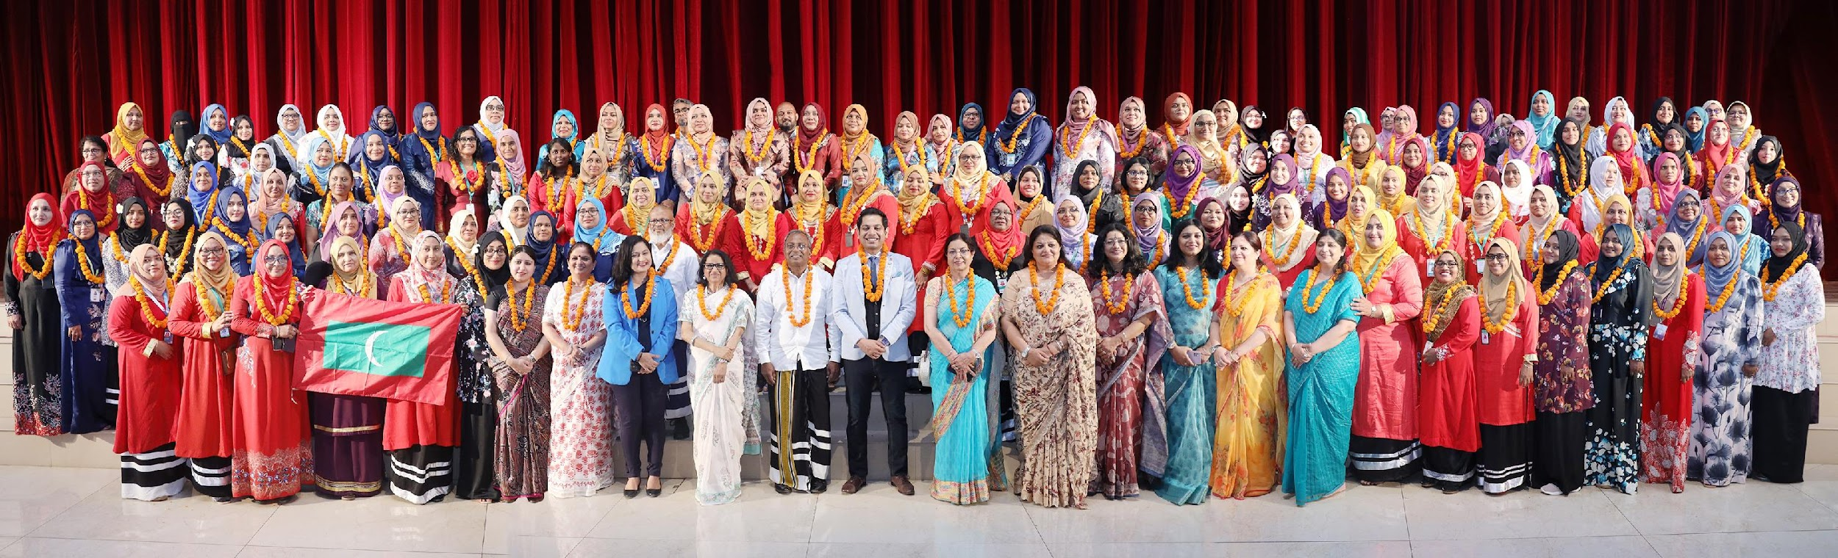


In May, 2023, a training of trainers was provided to some 30 teachers in Male by GETI trainers from India.
In September 2022 and July 2023, two delegations of 78 and 130 individuals consisting of Minister of State for Education, MOE/NIE Staff, School Heads, and Teachers visited India to study the ALfA method in practice.
In October 2023, an Online Training of 1200 teachers covering all schools and teachers of primary grades was conducted.
ALfA
Prior to the Pilot

Slide 5
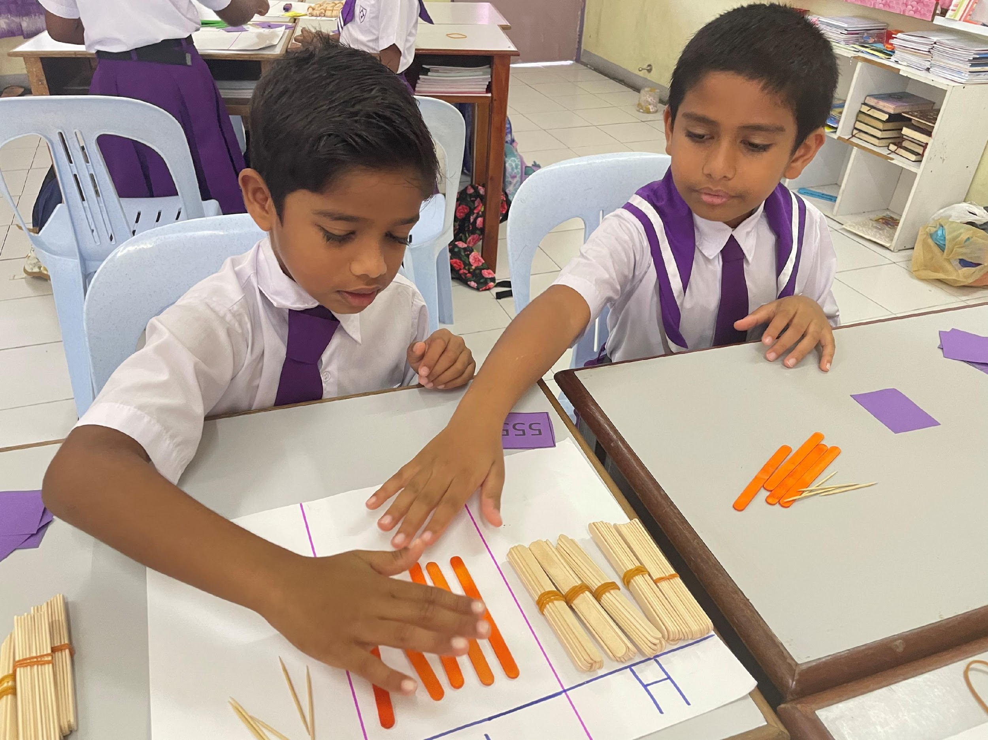
ALfA
The Pilot
The country began its pilot of the ALfA pedagogy and program in mid-August, 2023, for Lower KG, Upper KG, and Grades 1, 2 and 3.
While 10 of the 13 schools used ALfA printed study materials, 3 schools used online learning methods with content provided on the iProgress App.
The program began in 13 government schools in Treatment and 5 government schools in the Control Group. One of the schools was a pre-school. Both Control and Treatment schools did a Baseline Survey in mid-September and a Progress 1 Survey in mid-December.
Paper & Pencil Tests were monitored. Data was entered on OMR sheets and then scanned by the NIE staff using the Pragati App. They could see the reports instantly on uploading of data.

Slide 6
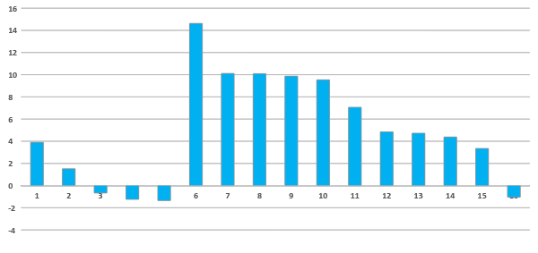
English Grade 3 Progress between Baseline and Progress Surveys
September 2023 (Baseline) to December 2023 (Progress 1)
In the chart below, the first five schools are in the Control Group and the next 12 schools are in the Treatment Group. Data is missing for Maradhoo School (last on the chart)
ALfA
ENGLISH
* At the time of this analysis data was missing for one school and one section in the Treatment Group. The Control Group data was final.

Slide 7
ENGLISH AVERAGE PERCENTAGES
Control Group | School Name | BASELINE SURVEY | PROGRESS SURVEY | Difference
 | Hamad Bin Khalifa Al Thani | 48.58 | 52.48 | 3.90
 | Madhrasathul Ifthithaah School | 61.18 | 59.83 | -1.35
 | Muhiyuhddin School | 47.49 | 46.25 | -1.24
 | Nooraanee School | 58.84 | 60.35 | 1.51
 | Vaavu Atoll Education Centre | 46.33 | 45.67 | -0.67
Treatment Group | Aminiya School | 56.31 | 63.37 | 7.06
 | GDH. Thinadhoo School | 52.50 | 57.22 | 4.72
 | Hafiz Ahmed School | 50.00 | 60.09 | 10.09
 | Hanimaadhoo School | 52.40 | 51.36 | -1.04
 | Hiriyaa School | 57.25 | 66.79 | 9.54
 | Huraa School | 62.63 | 72.50 | 9.87
 | Huravee School | 56.40 | 61.24 | 4.84
 | Kalaafaanu School | 62.42 | 72.53 | 10.11
 | Maakurathu School | 41.17 | 55.79 | 14.62
 | Maradhoo School
 | Mohamed Jamaluddin School | 58.08 | 62.46 | 4.38
 | Seenu Atoll School | 57.83 | 61.18 | 3.34
Treatment Group Averages |  | 56.70 | 63.94 | 7.24
Control Group Averages |  | 51.91 | 52.15 | 0.25
Results Analysis English
ALfA Treatment Group jumped by 7.24 percentage points versus 0.25 for the non-ALfA Control Group

Slide 8
English Grade 3 Progress between Baseline and Progress Surveys
September 2023 (Baseline) to December 2023 (Progress 1)
English Difference in Difference using Medians & Absolute Marks
 |  | 0-25 | 26-50 | 51-75 | 76-100 | 0-100
Treatment | No. of Students | 163 | 163 | 162 | 162 | 650
Control | No. of Students | 47 | 46 | 46 | 46 | 185
Grade 3 Progress | Median (T) | 36.67 | 66.67 | 73.33 | 83.33 | 70.00
 | Median (C) | 20.00 | 46.67 | 66.67 | 83.33 | 60.00
 | NDIFF=NAT-NAC | 16.67 | 20.00 | 6.67 | 0.00 | 10.00
Grade 3 Baseline | Median (T) | 26.67 | 56.67 | 70.00 | 80.00 | 63.33
 | Median (C) | 20.00 | 48.33 | 66.67 | 81.67 | 60.00
 | JDIFF=JAT-BARC | 6.67 | 8.33 | 3.33 | -1.67 | 3.33
DIFF IN DIFF | NDIFF-JDIFF | 10.00 | 11.67 | 3.33 | 1.67 | 6.67
ALfA
English
* At the time of this analysis data was missing for one school and one section in the Treatment Group. The Control Group data was final.

Slide 9
English Grade 3 Progress between Baseline and Progress Surveys
September 2023 (Baseline) to December 2023 (Progress 1)
ALfA
English
Overall
Effect Size
0.43
* At the time of this analysis data was missing for one school and one section in the Treatment Group. The Control Group data was final.
English Difference in Difference using Standardized Marks
 |  | 0-25 | 26-50 | 51-75 | 76-100 | 0-100
Grade 3 Progress | Median (T) | 0.69 | 2.07 | 2.38 | 2.84 | 2.23
 | Median (C) | -0.20 | 0.86 | 1.66 | 2.33 | 1.40
 | NDIFF=NAT-NAC | 0.89 | 1.21 | 0.72 | 0.51 | 0.83
Grade 3 Baseline | Median (I) | 0.17 | 1.49 | 2.08 | 2.52 | 1.79
 | Median (R) | -0.23 | 0.86 | 1.56 | 2.14 | 1.31
 | JDIFF=JAT-BARC | 0.40 | 0.64 | 0.52 | 0.38 | 0.48
DIFF IN DIFF | NDIFF-JDIFF | 0.49 | 0.57 | 0.20 | 0.13 | 0.35

Slide 10
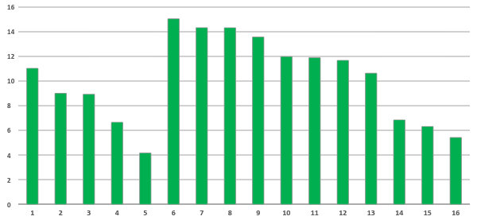
Mathematics Grade 3 Schoolwise Progress between Baseline and Progress Surveys
September 2023 (Baseline) to December 2023 (Progress 1)
In the Progress Chart for each school below, the first five schools are in the Control Group and the next 12 schools are in the Treatment Group. Data is missing for Maradhoo School (last on the chart)
ALfA
Mathematics
* At the time of this analysis data was missing for one school and one section in the Treatment Group. The Control Group data was final.

Slide 11
MATHEMATICS AVERAGE PERCENTAGES
 | SchoolName | BASELINE SURVEY | PROGRESS SURVEY | Difference
Control Group | Hamad Bin Khalifa Al Thani | 29.87 | 40.90 | 11.03
 | Madhrasathul Ifthithaah School | 41.01 | 49.92 | 8.92
 | Muhiyuhddin School | 31.16 | 37.81 | 6.65
 | Nooraanee School | 33.91 | 38.07 | 4.16
 | Vaavu Atoll Education Centre | 24.67 | 33.67 | 9.00
Treatment Group | Aminiya School | 35.42 | 42.26 | 6.84
 | GDH. Thinadhoo School | 35.67 | 47.35 | 11.67
 | Hafiz Ahmed School | 30.26 | 44.58 | 14.32
 | Hanimaadhoo School | 32.92 | 38.33 | 5.42
 | Hiriyaa School | 32.91 | 44.80 | 11.89
 | Huraa School | 37.96 | 48.60 | 10.63
 | Huravee School | 32.01 | 43.99 | 11.98
 | Kalaafaanu School | 36.00 | 49.58 | 13.57
 | Maakurathu School | 22.46 | 37.50 | 15.04
 | Maradhoo School
 | Mohamed Jamaluddin School | 29.63 | 43.96 | 14.33
 | Seenu Atoll School | 31.40 | 37.71 | 6.30
Treatment Group Averages |  | 33.22 | 44.50 | 11.28
Control Group Averages |  | 34.10 | 43.16 | 9.07
Results Analysis Mathematics
ALfA Treatment Group jumped by 11.28 percentage points versus 9.07 for the non-ALfA Control Group

Slide 12
Mathematics Grade 3 Progress between Baseline and Progress Surveys
September 2023 (Baseline) to December 2023 (Progress 1)
Mathematics Difference in Difference using Medians & Absolute Marks
 |  | 0-25 | 26-50 | 51-75 | 76-100 | 0-100
Treatment | No. of Students | 167 | 166 | 166 | 166 | 665
Control | No. of Students | 45 | 44 | 44 | 44 | 177
Grade 3 Progress | Median (T) | 26.67 | 36.67 | 48.33 | 66.67 | 43.33
 | Median (C) | 26.67 | 36.67 | 43.33 | 71.67 | 40.00
 | NDIFF=NAT-NAC | 0.00 | 0.00 | 5.00 | -5.00 | 3.33
Grade 3 Baseline | Median (T) | 13.33 | 26.67 | 36.67 | 56.67 | 33.33
 | Median (C) | 16.67 | 26.67 | 40.00 | 60.00 | 33.33
 | JDIFF=JAT-BARC | -3.33 | 0.00 | -3.33 | -3.33 | 0.00
DIFF IN DIFF | NDIFF-JDIFF | 3.33 | 0.00 | 8.33 | -1.67 | 3.33
ALfA
Mathematics
* At the time of this analysis data was missing for one school and one section in the Treatment Group. The Control Group data was final.

Slide 13
Mathematics Grade 3 Progress between Baseline and Progress Surveys
September 2023 (Baseline) to December 2023 (Progress 1)
ALfA
Mathematics
Overall
Effect Size
0.16
* At the time of this analysis data was missing for one school and one section in the Treatment Group. The Control Group data was final.
Mathematics Difference in Difference using Standardized Marks
 |  | 0-25 | 26-50 | 51-75 | 76-100 | 0-100
Grade 3 Progress | Median (T) | 0.29 | 0.77 | 1.34 | 2.22 | 1.09
 | Median (C) | 0.23 | 0.69 | 0.99 | 2.30 | 0.84
 | NDIFF=NAT-NAC | 0.06 | 0.08 | 0.34 | -0.08 | 0.25
Grade3 Baseline | Median (I) | -0.31 | 0.37 | 0.89 | 1.91 | 0.71
 | Median (R) | -0.12 | 0.41 | 1.12 | 2.18 | 0.77
 | JDIFF=JAT-BARC | -0.20 | -0.04 | -0.23 | -0.27 | -0.05
DIFF IN DIFF | NDIFF-JDIFF | 0.26 | 0.13 | 0.58 | 0.19 | 0.31

Slide 14
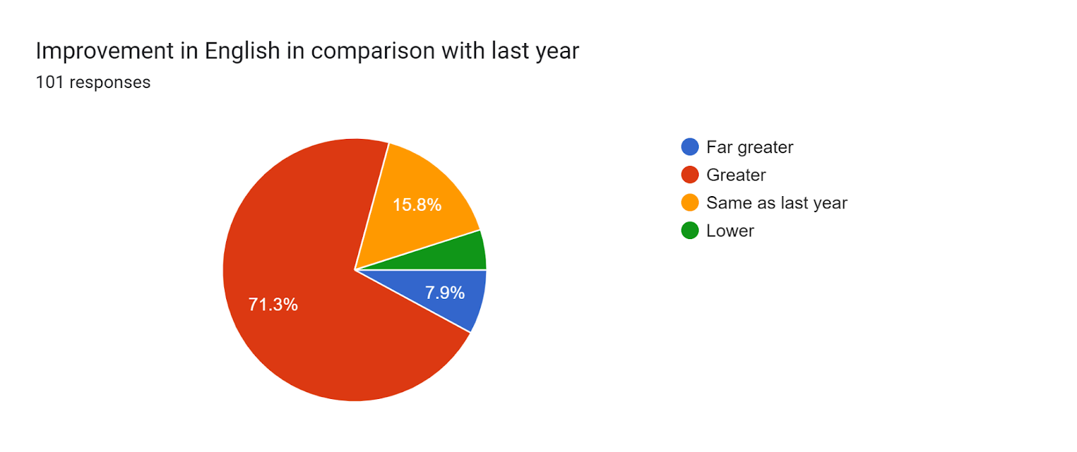
English Progress vs Last Year
ALfA Group Teacher Views on the Question:
What was the improvement in English in comparison to last year?
101 responses

Slide 15
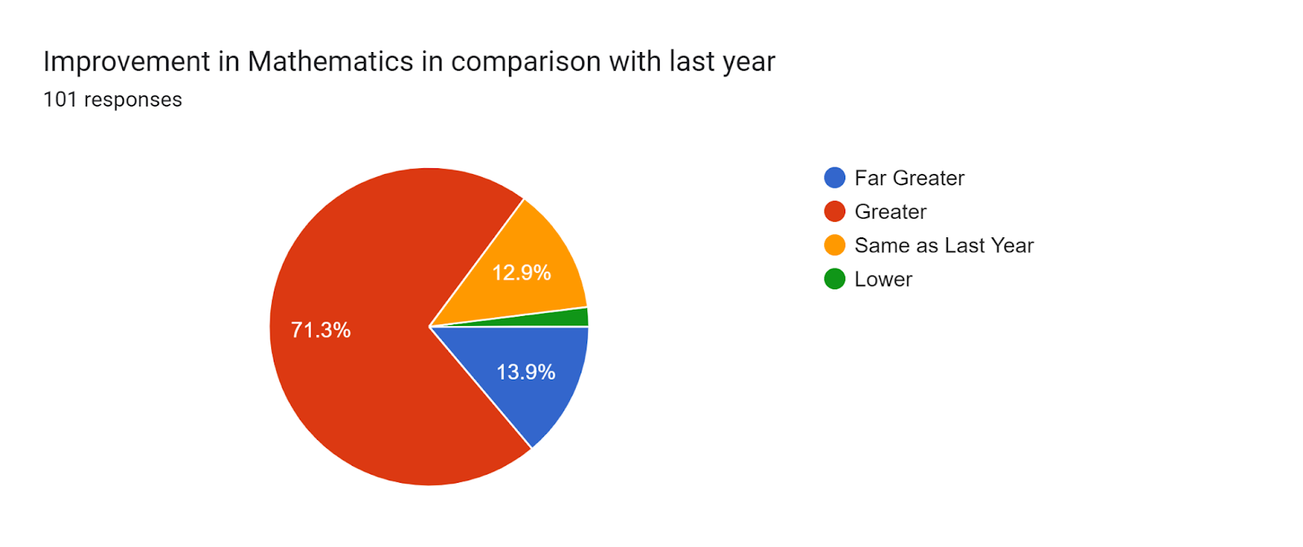
Mathematics Progress vs Last Year
ALfA Group Teacher Views on the question:
What was the improvement in Mathematics in comparison to last year?
101 responses

Slide 16

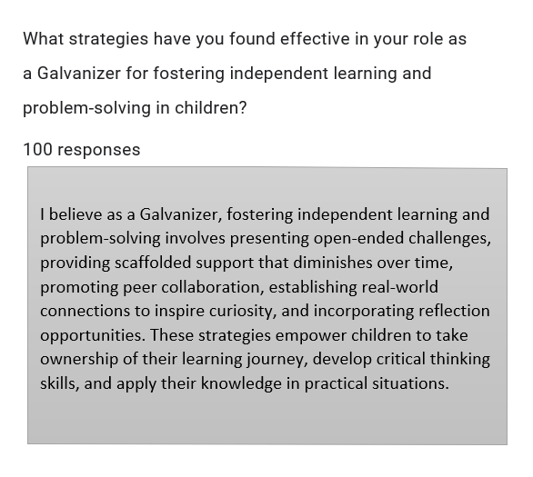
Galvanizers' Perspective
Confidence in the ALfA Journey
What strategies have you found effective in your role as a Galvanizer for fostering independent learning and problem-solving in children?
101 responses
Ayshrth Sumaa

Slide 17
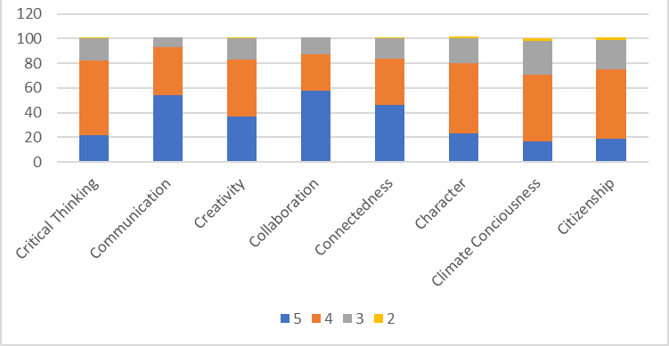
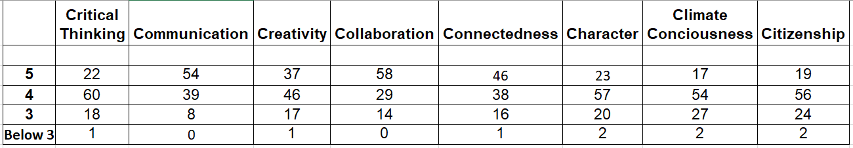
Gauging Growth
Rating the 4C Skills + 4C Traits Development in Children
On a scale of 1 to 5, how much have each of the 4C Skills + 4C Traits developed in your children compared to last year?
4C Skills: Collaboration, Communication, Critical Thinking, Creativity
4C Traits: Character, Connectedness, Climate Consciousness and Citizenship

Slide 18
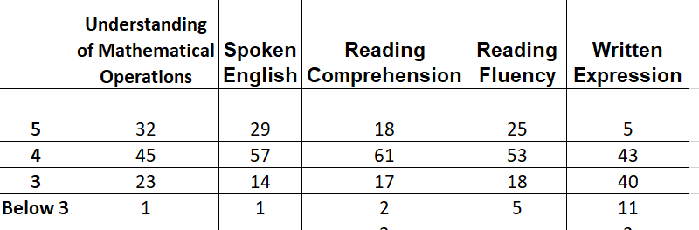
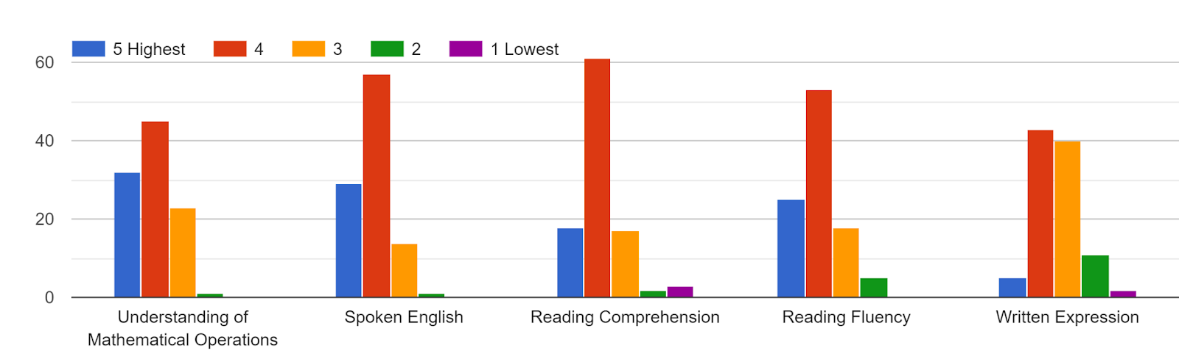
Yearly Educational Progress
Rating Mathematics, English, and Writing Skills
On a scale of 1 to 5, how do you rate the following compared with last year.

Slide 19

Strategic Teaching
Empowering Independent Learning and Problem-Solving
What strategies have you found effective in your role as a Galvanizer for fostering independent learning and problem-solving in children?
101 responses

Slide 20
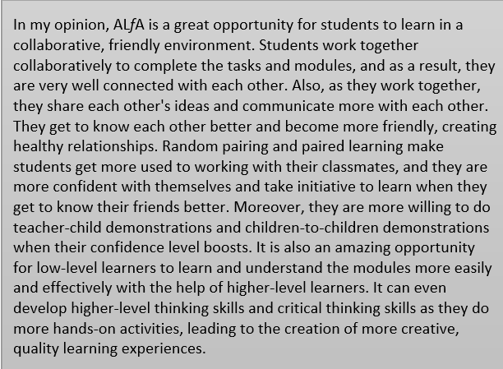

ALfA Narratives
Individual Insights and Reflections
ALfA in Your View + Your Picture
101 responses
Hawwa Lamsha

Slide 21
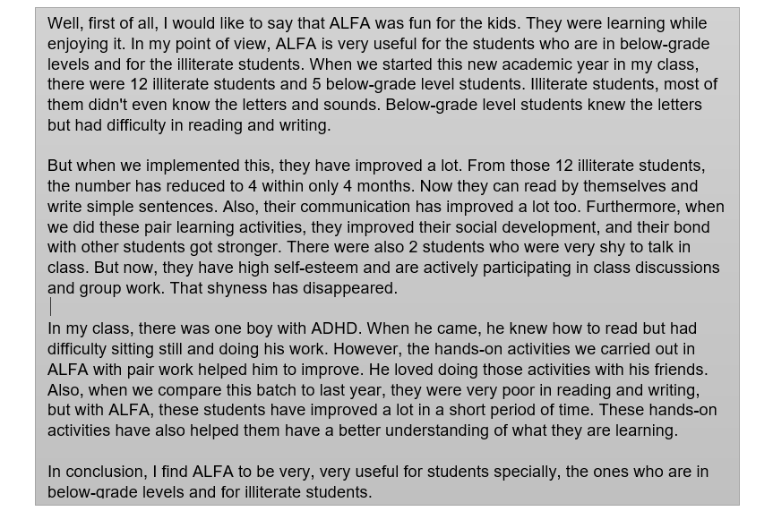

ALfA in Your View + Your Picture
101 responses
Mariyam Zuha

Slide 22
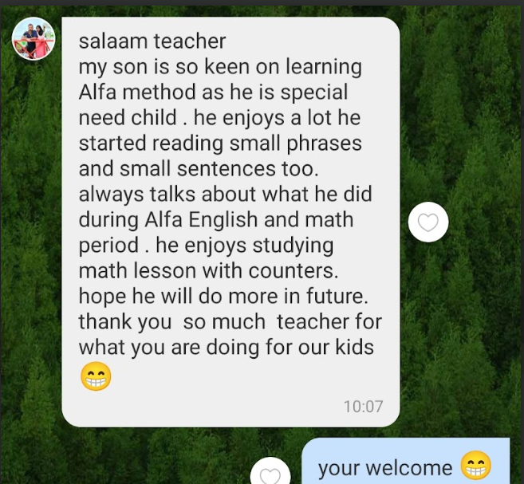
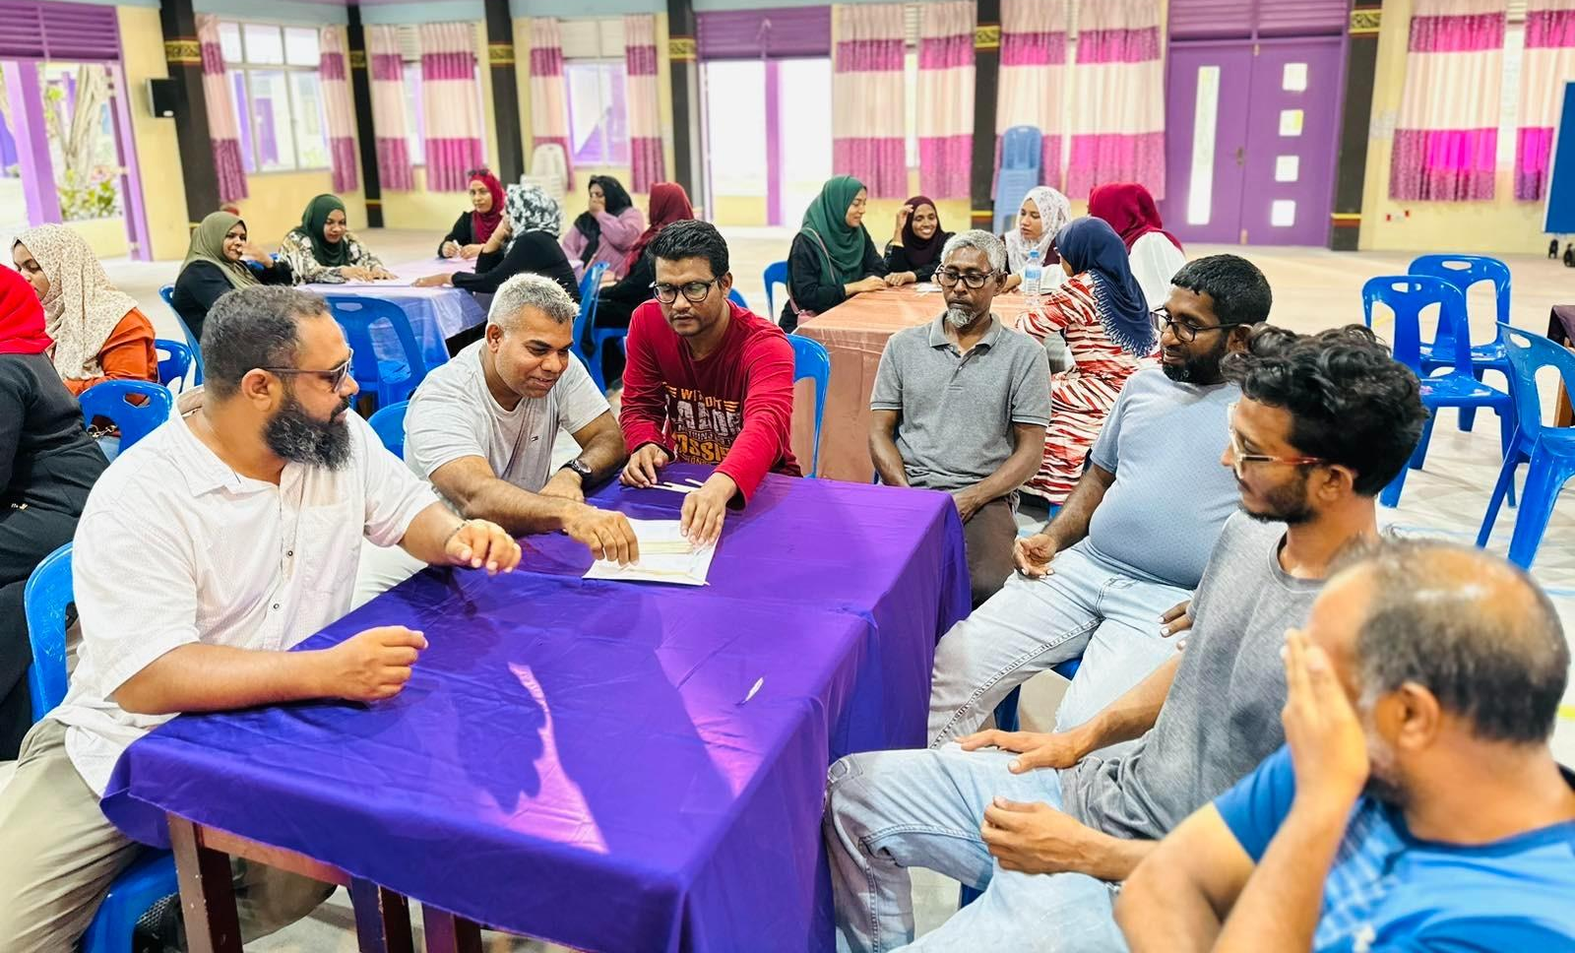
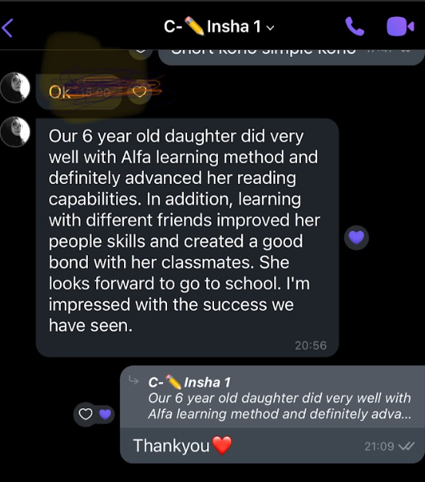
Through Parents' Eyes
Real Stories, Real Impact

Slide 23


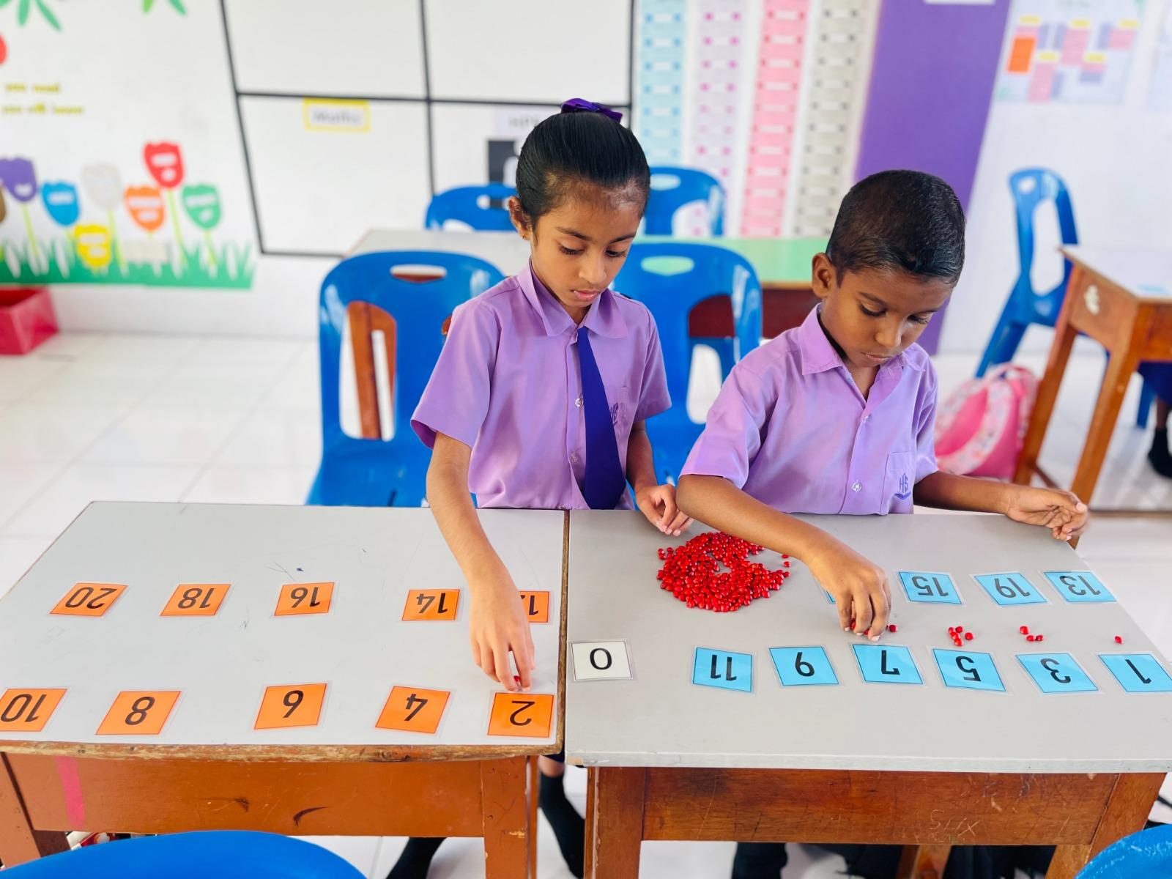
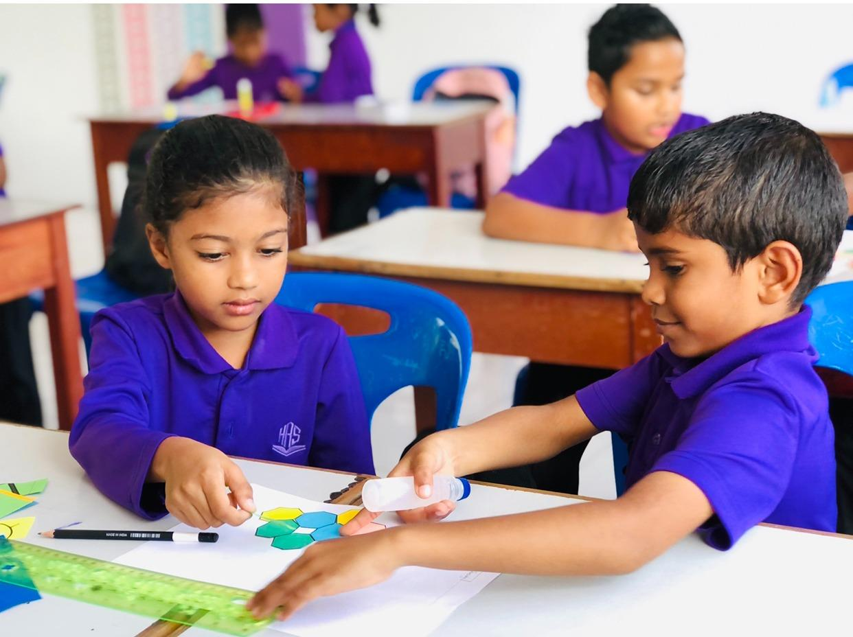
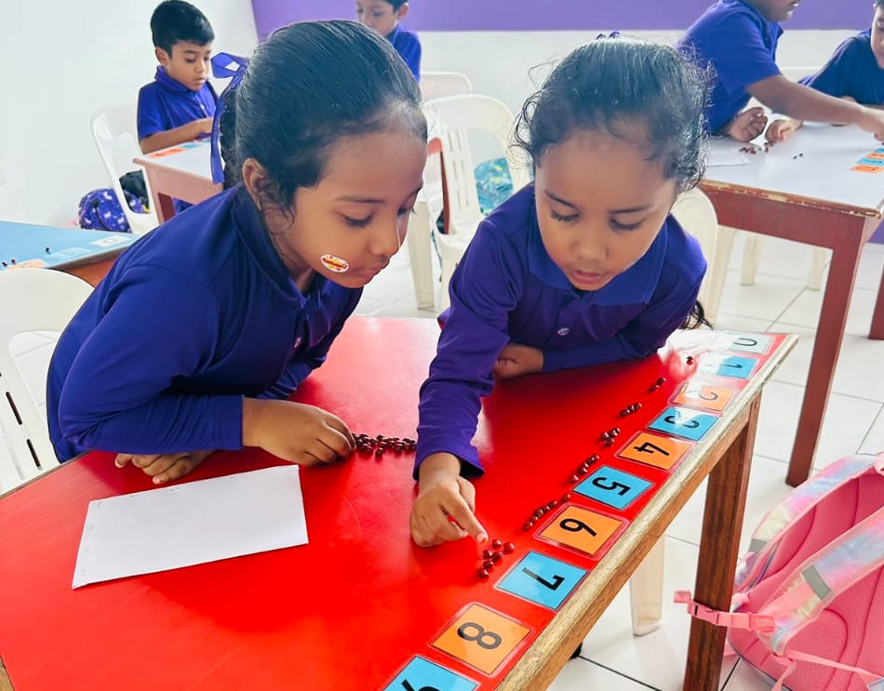
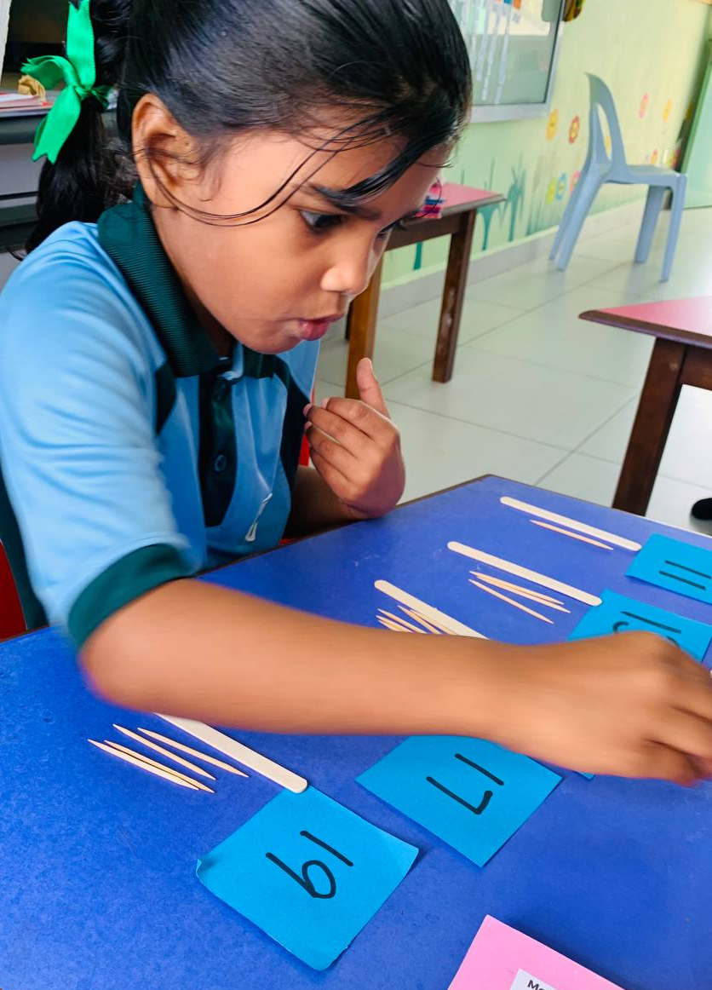

Slide 24
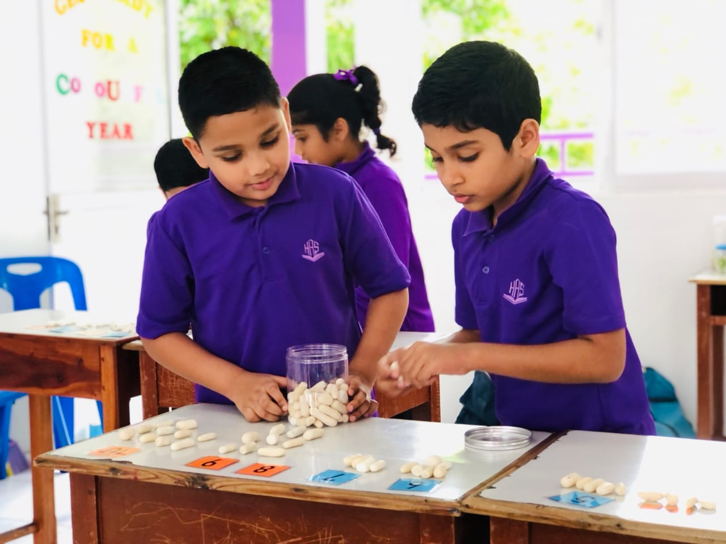
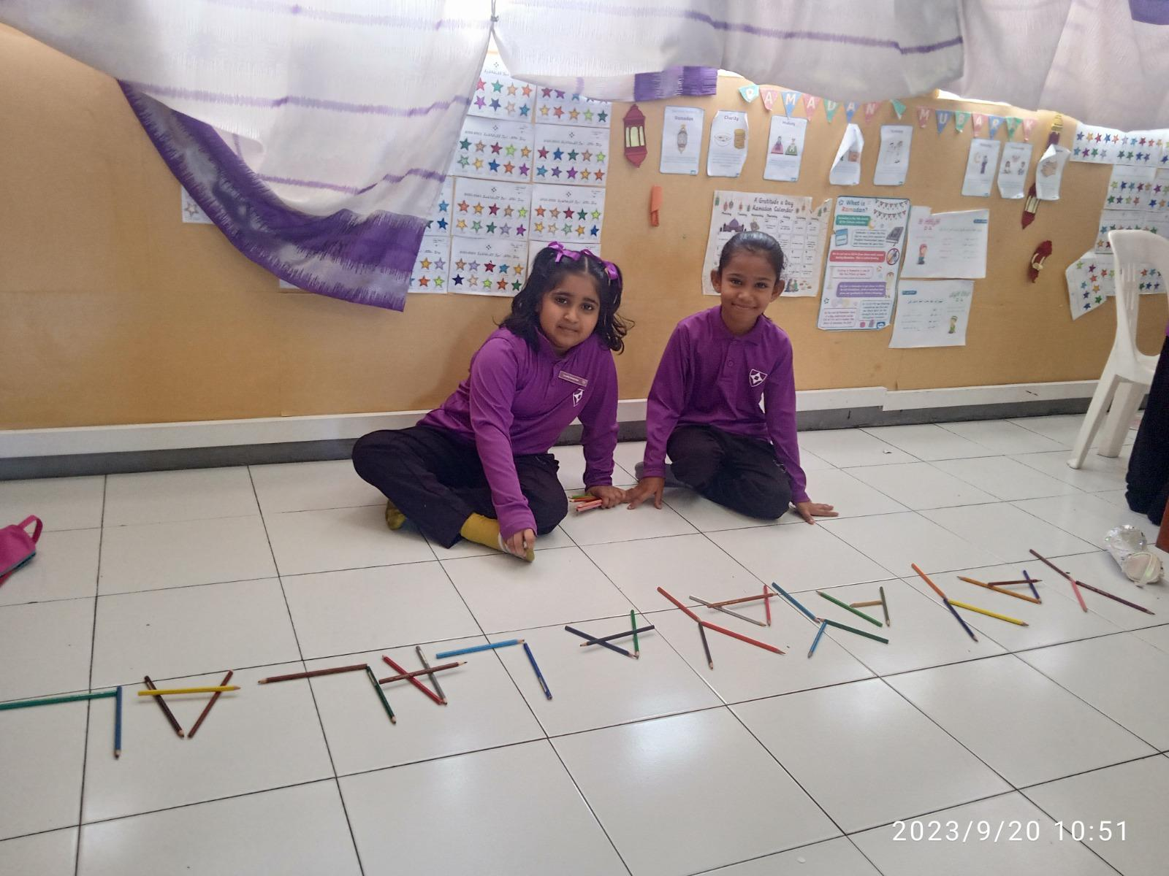
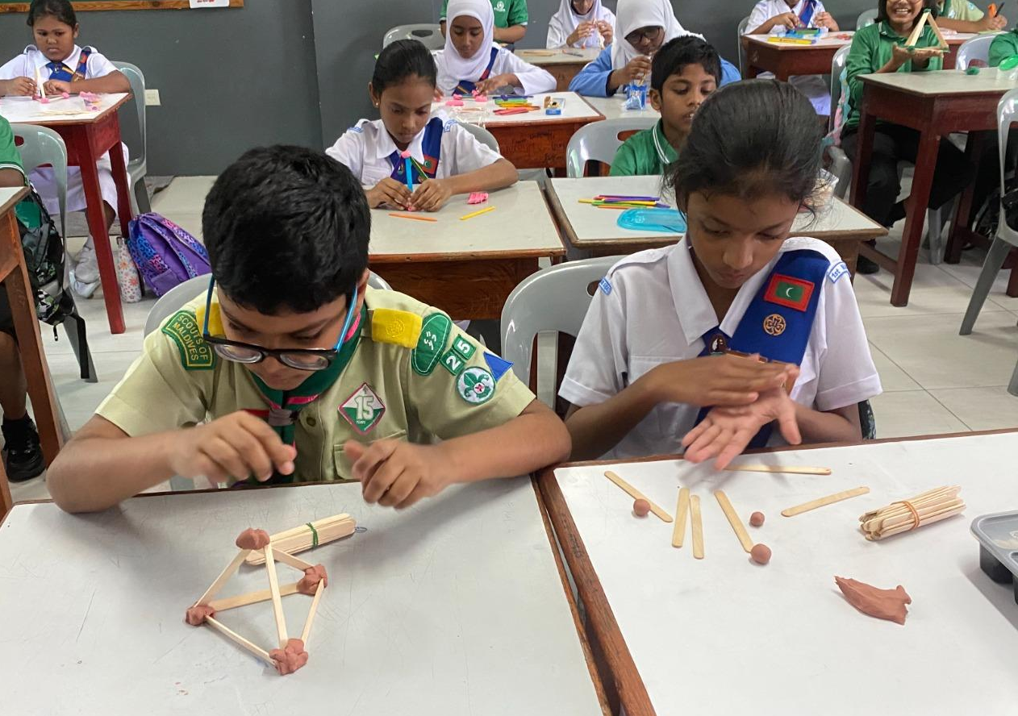

Slide 25
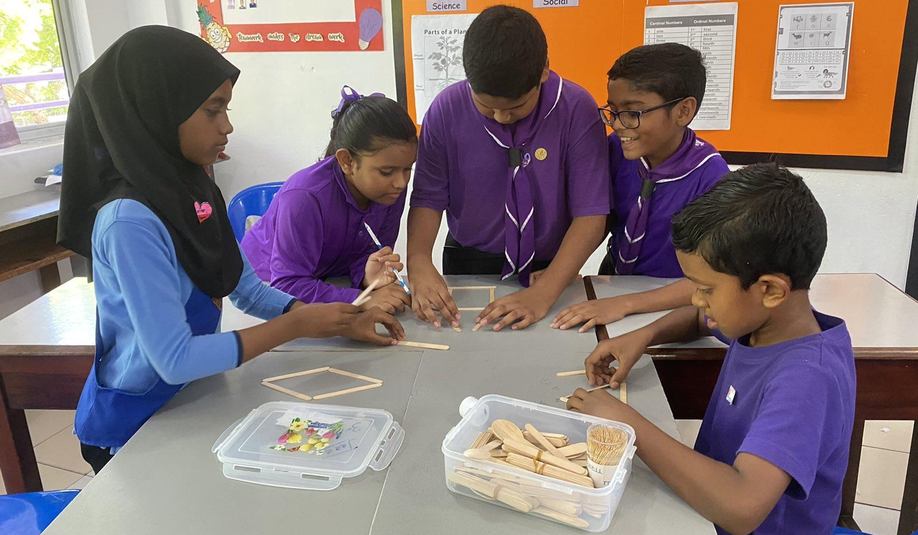
Thank You

